Slide 1
The Sevenfold Gift of the Holy Spirit: Freedom and Life
The Sevenfold Gift of the Holy Spirit:
Freedom and Life
The Very Rev. Dr. Cynthia Briggs Kittredge
Seminary of the Southwest
Artwork by He Qi
Notes:
Help!

Slide 2
Freedom and Life: Outline
Freedom and Life
The Spirit in Scripture – Old and New Testament – Spirit in and of Jesus, In and of the Church
The Spirit and Creation
The Promise of the Spirit in the Prophets
The Spirit and Easter
The Spirit and Baptism
The Spirit in the Life of Jesus
Spirit – Mighty Wind, Gentle Breath – Offering Freedom and Life
Notes:
Help!

Slide 3
Freedom and Life
The Spirit in Scripture – Old and New Testament
Spirit in Jesus, Spirit of Jesus, Spirit in and of the Church
Notes:
Help!

Slide 4
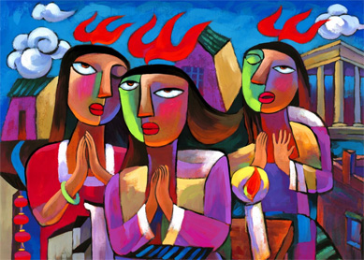
Freedom and Life
Notes:
Help!

Slide 5
Freedom and Life
How might the Spirit, the Holy Spirit, be active in the community of Christ now,
and in our parish and fellowship communities,
and in our own individual lives?
What is the Spirit calling us to do, allowing us to do, inviting us to do?
Notes:
Help!

Slide 6
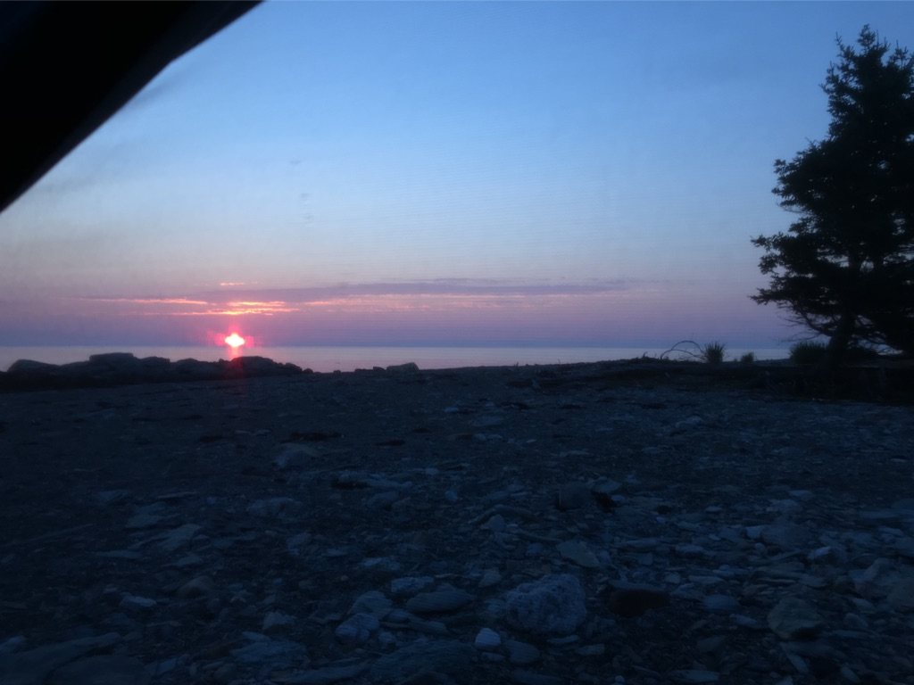
Freedom and Life
In the beginning when God created the heavens and the earth, ² the earth was a formless void and darkness covered the face of the deep, while a wind from God swept over the face of the waters. ³ Then God said, “Let there be light”; and there was light. ⁴ And God saw that the light was good; and God separated the light from the darkness. ⁵ God called the light Day, and the darkness he called Night. And there was evening and there was morning, the first day.
Notes:
Help!

Slide 7
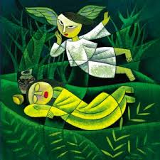
Freedom and Life
In the day that the LORD God made the earth and the heavens, ⁵ when no plant of the field was yet in the earth and no herb of the field had yet sprung up—for the LORD God had not caused it to rain upon the earth, and there was no one to till the ground; ⁶ but a stream would rise from the earth, and water the whole face of the ground— ⁷ then the LORD God formed man from the dust of the ground, and breathed into his nostrils the breath of life; and the man became a living being.
Notes:
Help!

Slide 8
Freedom and Life
The Prophet Joel promises God’s Spirit in abundance
Then afterward
I will pour out my spirit on all flesh;
your sons and your daughters shall prophesy,
your old men shall dream dreams,
and your young men shall see visions.
Even on the male and female slaves,
in those days, I will pour out my spirit.
Notes:
Help!

Slide 9
Freedom and Life
What are the effects of the Spirit?
Notes:
Help!

Slide 10
Freedom and Life
After Jesus’ Resurrection his followers experienced the Risen Jesus among them
healing, comforting, giving vision, commissioning.
Notes:
Help!

Slide 11
Freedom and Life
The earliest Jesus believers, after the resurrection, did three things.
Notes:
Help!

Slide 12
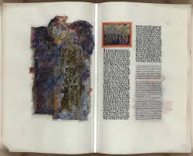
Freedom and Life
They read Scripture.
Notes:
Help!

Slide 13
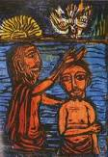
Freedom and Life
They baptized.
³ Do you not know that all of us who have been baptized into Christ Jesus
were baptized into his death?
⁴ Therefore we have been buried with him by baptism into death,
so that, just as Christ was raised from the dead by the glory of the Father,
so we too might walk in newness of life.
Notes:
Help!

Slide 14
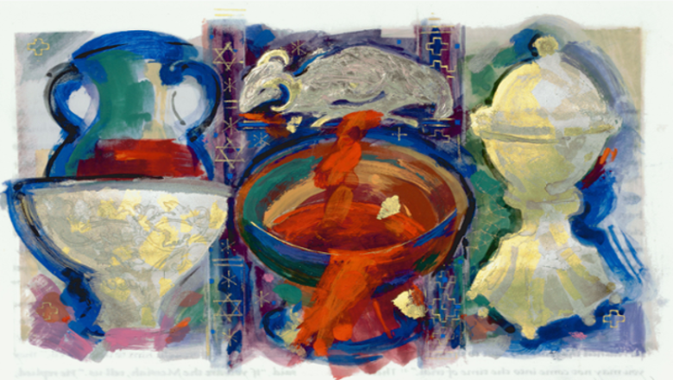
Freedom and Life
They celebrated the Eucharist.
“On the night in which he died, he took bread.”
Notes:
Help!

Slide 15
Freedom and Life
The Spirit was especially associated with baptism.
Galatians. 3:23
Now before faith came, we were imprisoned and guarded under the law until faith would be revealed.
²⁴ Therefore the law was our disciplinarian until Christ came, so that we might be justified by faith.
²⁵ But now that faith has come, we are no longer subject to a disciplinarian,
²⁶ for in Christ Jesus you are all children of God through faith.
²⁷ As many of you as were baptized into Christ have clothed yourselves with Christ.
²⁸ There is no longer Jew or Greek, there is no longer slave or free,
there is no longer male and female; for all of you are one in Christ Jesus.

Slide 16
Freedom and Life
The Spirit was especially associated with baptism.
Colossians. 3:5 Put to death, therefore, whatever in you is earthly: fornication, impurity, passion, evil desire,
and greed (which is idolatry). ⁶ On account of these the wrath of God is coming on those who are disobedient.
⁷ These are the ways you also once followed, when you were living that life.
⁸ But now you must get rid of all such things—anger, wrath, malice, slander, and abusive language from your mouth.
⁹ Do not lie to one another, seeing that you have stripped off the old self with its practices
¹⁰ and have clothed yourselves with the new self,
which is being renewed in knowledge according to the image of its creator.
¹¹ In that renewal there is no longer Greek and Jew, circumcised and uncircumcised,
barbarian, Scythian, slave and free; but Christ is all and in all!

Slide 17
Freedom and Life
The Spirit was especially associated with baptism.
Rom. 8:12 So then, brothers and sisters, we are debtors, not to the flesh, to live according to the flesh—
¹³ for if you live according to the flesh, you will die; but if by the Spirit you put to death the deeds of the body,
you will live. ¹⁴ For all who are led by the Spirit of God are children of God.
¹⁵ For you did not receive a spirit of slavery to fall back into fear, but you have received a spirit of adoption.
When we cry, “Abba! Father!” ¹⁶ it is that very Spirit bearing witness with our spirit that we are children of God,
¹⁷ and if children, then heirs, heirs of God and joint heirs with Christ—if, in fact, we suffer with him
so that we may also be glorified with him.

Slide 18
Freedom and Life
The Spirit was especially associated with baptism.
"hope does not disappoint us, because God’s love has been poured into our hearts through the Holy Spirit
that has been given to us."

Slide 19
Freedom and Life
The Spirit was especially associated with baptism.
"hope does not disappoint us, because God’s love has been poured into our hearts through the Holy Spirit
that has been given to us."

Slide 20
Freedom and Life
The Spirit was especially associated with baptism.
"hope does not disappoint us, because God’s love has been poured into our hearts through the Holy Spirit
that has been given to us."

Slide 21
Freedom and Life
Metaphors for the Holy Spirit
Water
Wind
Cloud

Slide 22
Freedom and Life
FREEDOM
– Capacity to be a beloved child
Change in relationships
a new way of life, a new way to walk.

Slide 23
Freedom and Life
The Holy Spirit could be disruptive….

Slide 24
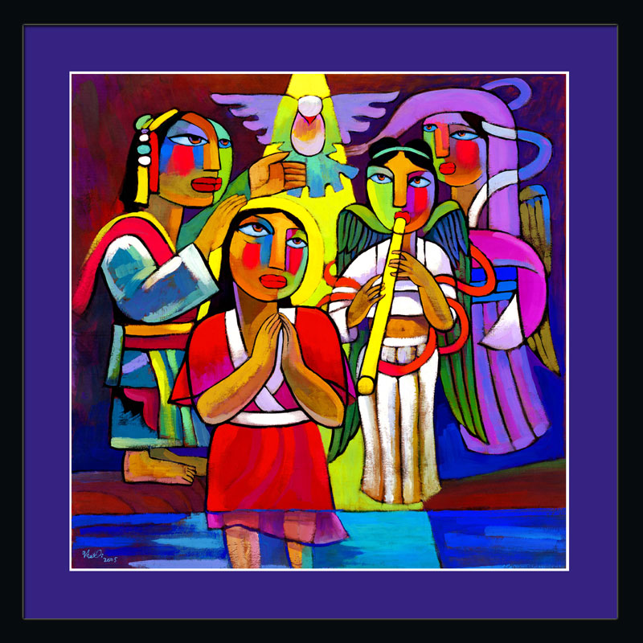
Freedom and Life
The Baptism of Jesus

Slide 25
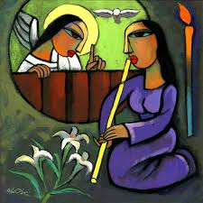
Freedom and Life
Jesus Conceived by the
Holy Spirit

Slide 26
Freedom and Life
Two Stories of Pentecost
When it was evening on that day, the first day of the week, and the doors of the house where the disciples
had met were locked
for fear of the Jews, Jesus came and stood among them and said, “Peace be with you.”
After he said this, he showed them his hands and his side.
Then the disciples rejoiced when they saw the Lord.
Jesus said to them again, “Peace be with you. As the Father has sent me, so I send you.”
When he had said this, he breathed on them and said to them, “Receive the Holy Spirit.
If you forgive the sins of any, they are forgiven them; if you retain the sins of any, they are retained.”

Slide 27
Freedom and Life
A Wilder One
When the day of Pentecost had come, they were all together in one place.
And suddenly from heaven there came a sound like the rush of a violent wind,
and it filled the entire house where they were sitting.
Divided tongues, as of fire, appeared among them, and a tongue rested on each of them.
All of them were filled with the Holy Spirit and began to speak in other languages, as the Spirit gave them ability.

Slide 28
Freedom and Life
Spirit – Mighty Wind, Gentle Breath – Offering Freedom and Life

